Slide 1
Plant Disease Detection Using CNN
Team Mentor: Team Members:
Mr. C.V.S. Satyamurty G. Srinivas
Associate Professor (17B81A12A3)
IT Department J.Sai Surya Reddy
(17B81A1274)
B. Shivakumar
(17B81A1289)

Slide 2
ABSTRACT
Plant diseases are of numerous kinds. Recognizing each one of them would be a tedious task for a human being, but a machine can solve this issue. The Machine Learning deals with classification and used to classify healthy and unhealthy plants. Classification can be done by using decision tree, neural network etc. We are proposing a web application which helps in identifying the disease type for the given input from a trained data set using “Convolutional Neural Network”, a deep learning algorithm.

Slide 3
INTRODUCTION
Plant disease has long been one of the major threats to food security because it dramatically reduces the crop yield and compromises its quality.
They are classified into many categories based on plant types.
Identification of plant diseases has relied on human annotation by visual inspection .
Later array of image-based diagnosis has been evolved.

Slide 4
Deep learning is a branch of machine learning which is completely based on artificial neural networks.
It’s a kind of mimic of human brain.
In these scenario, deep learning is typically used and among various network architectures CNN is opted.
Convolutional Neural Networks (CNN) are widely used in image classification, recognition etc.

Slide 5
LITERATURE REVIEW
Traditionally plant pathologists often help to identify the disease manually when a sample is given to them.
One of the methods related to Machine learning named k-means clustering gives greater efficiency when applied on large datasets , and SVM is used for classification in this process.
The training time of Support vector machine is slow but they are highly accurate.
Training time for traditional SVM algorithms increases with the huge data. So, not feasible for large data sets.

Slide 6
Many disease exhibit general symptoms that are caused by different pathogens produced by leaves, roots etc.
Images often do not posses sufficient details to assist in diagnosis.
“Identification and classification of fungal disease affected on agriculture/horticulture crops using image processing techniques”
Detection of unhealthy region in plant leaves and classification of diseases using textural features also available.

Slide 7
FUNCTIONAL REQUREMENTS
User can choose their preferred and convenient language.
User can upload the testing plant sample image into the website.
User can get remedies to prevent the particular disease.

Slide 8
NON FUNCTIONAL REQUIREMENTS
Performance: User will get the desired output within couple of minutes, without getting interrupted.
Compatible: website is compatible with multiple browsers.
Scalability: the algorithm can handle large data sets.
Reliability: the probability of accurate disease prediction is more because the algorithm is well organized.

Slide 9
PROBLEM STATEMENT
Plant diseases are the major issue which can affect the agriculture and results in huge loss on the crop yield.
So, How to find a solution that could detect a plant disease specifically (tomato plant) accurately without any physical inspection?
Can Evolution of Technology helps us to find the solution for this problem?

Slide 10
MOTIVATION
Now a days new age ‘Farmers’ who are exhibiting their interest in farming struggles to identify the crop disease extensively . This web application could be a helping hand.
SCOPE
It will serve as a platform for farmers and person with no knowledge about diseases.
Web application is deployed with a trained model which is flexible to use and get the information about the tomato plant disease.

Slide 11
MODULES
CNN Algorithm Module:
The dataset is collected then split into two parts, normally into 80% of training and 20% of validation set.
The dataset is preprocessed such as Image reshaping, resizing and conversion to an array form.
The train dataset is used to train the model (CNN) so that it can identify the test image and the disease it has.
If we give a new image to the model to predict its outcome belong to any one of the classes.

Slide 12
Django Module:
This module acts as a server for the web application .
It stores and load the model which in turn returns the predicted disease to the user.
Translation Module:
This module consists of language translation.
Translation API is used in this module.
UI Module:
This module facilitates the user by predicting the disease of uploaded image and also with some basic remedies to it.

Slide 13
HARDWARE REQUIREMENTS
(Developer):
GPU :NVIDIA-SMI 460.32
Intel(R) Core™ i3-1005G1 CPU @ 1.20GHz
8 GB RAM.
25 GB HDD free space.
Windows (7 or higher) or Linux (Ubuntu 18.04 or equivalent )
(User):
1.9 (GHz) x64-bit dual core processor
2 GB RAM
Windows or Linux (OS)

Slide 14
SOFTWARE REQUIREMENTS
Python(3.7)
TensorFlow(2.4.1)
Keras(2.4.3)
Keras-Preprocessing(1.1.2)
Google-API
React JS(17.0.2 )
Django REST framework
Bootstrap 4
JavaScript
HTML5
CSS3

Slide 15
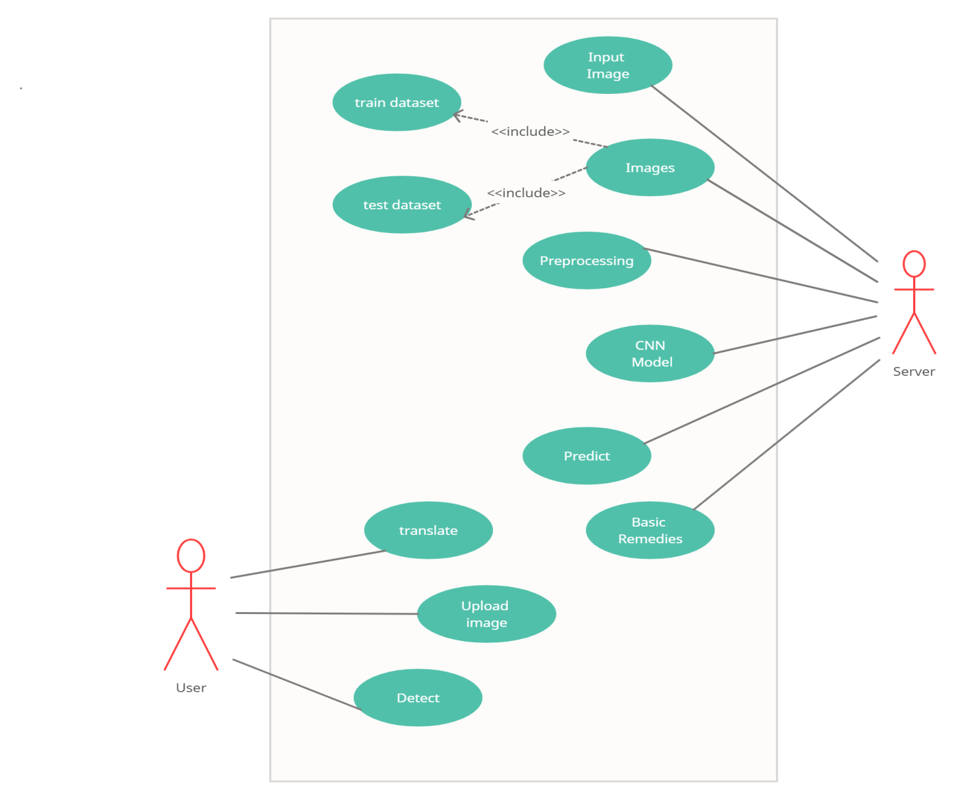
USE CASE Diagram

Slide 16
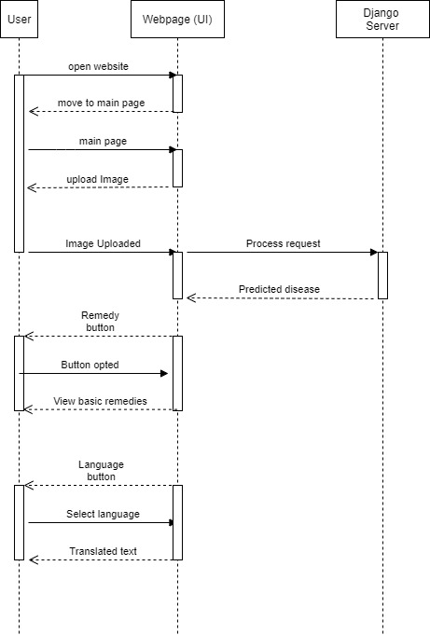
Sequence Diagram

Slide 17
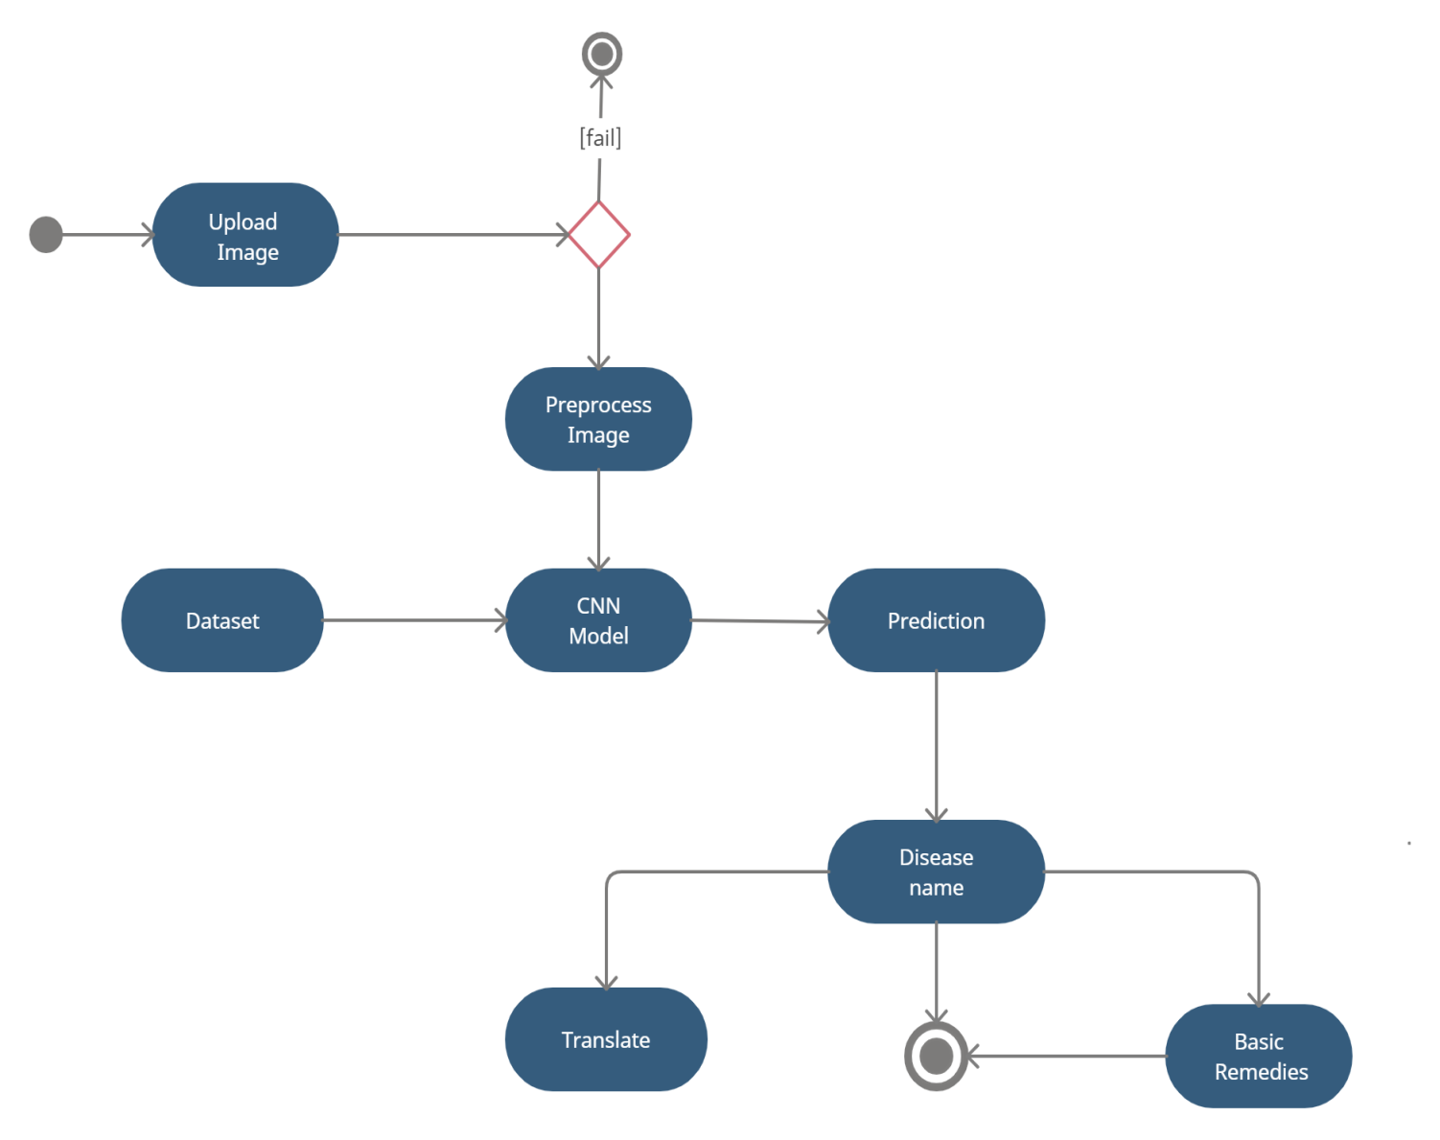
Activity Diagram

Slide 18
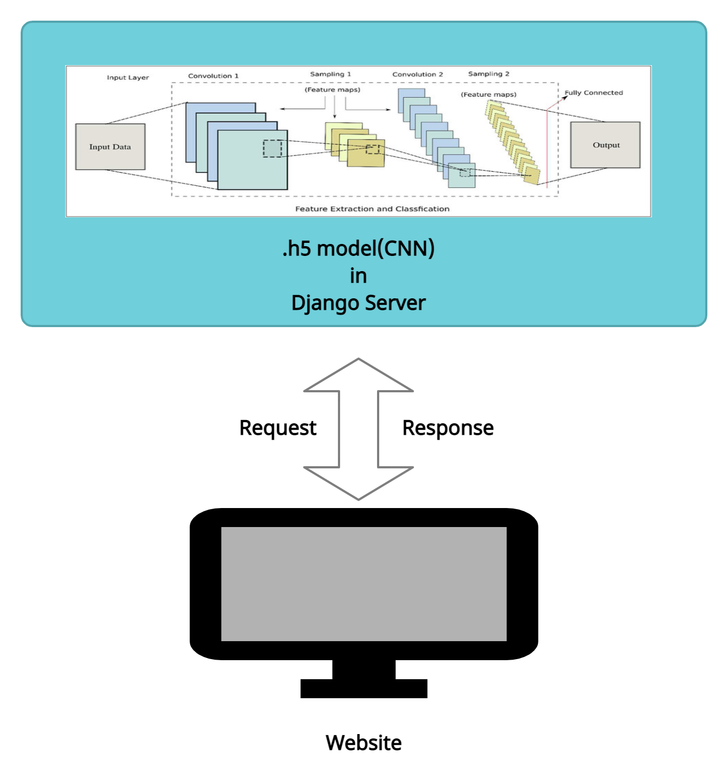
Architectural Diagram

Slide 19
CNN
Convolution
Activation(relu )
Pooling
Flattening
Dense

Slide 20
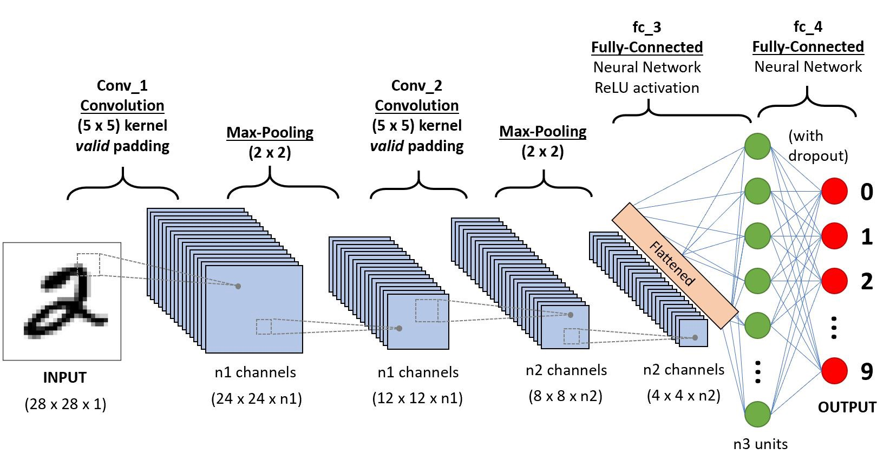

Slide 21
Model Accuracy
Epoch 1/10
574/574 [==============================] - 562s 979ms/step - loss: 0.3985 - accuracy: 0.8886 - val_loss: 1.0299 - val_accuracy: 0.6678
Epoch 2/10
574/574 [==============================] - 571s 995ms/step - loss: 0.3210 - accuracy: 0.9079 - val_loss: 0.9085 - val_accuracy: 0.7202
Epoch 3/10
574/574 [==============================] - 588s 1s/step - loss: 0.2627 - accuracy: 0.9284 - val_loss: 0.1849 - val_accuracy: 0.9430
Epoch 4/10
574/574 [==============================] - 577s 1s/step - loss: 0.2257 - accuracy: 0.9388 - val_loss: 0.6800 - val_accuracy: 0.7906
Epoch 5/10
574/574 [==============================] - 571s 995ms/step - loss: 0.2129 - accuracy: 0.9401 - val_loss: 0.8434 - val_accuracy: 0.7515
Epoch 6/10
574/574 [==============================] - 562s 980ms/step - loss: 0.1753 - accuracy: 0.9532 - val_loss: 1.5146 - val_accuracy: 0.5580
Epoch 7/10
574/574 [==============================] - 562s 979ms/step - loss: 0.1514 - accuracy: 0.9603 - val_loss: 0.2547 - val_accuracy: 0.9247
Epoch 8/10
574/574 [==============================] - 564s 983ms/step - loss: 0.1400 - accuracy: 0.9621 - val_loss: 0.1561 - val_accuracy: 0.9503
Epoch 9/10
574/574 [==============================] - 571s 996ms/step - loss: 0.1290 - accuracy: 0.9636 - val_loss: 0.5355 - val_accuracy: 0.8404
Epoch 10/10
574/574 [==============================] - 563s 981ms/step - loss: 0.1334 - accuracy: 0.9632 - val_loss: 0.0728 - val_accuracy: 0.9791

Slide 22
CONCLUSION
Tomato leaf disease prediction is deployed through a website for a user friendly interaction to the users.
It looks forward to help and encourage a farmer who has interest in cultivation but drags back for small practical issues faced in the process.
This website is a helping hand for those who are willing to start farming .

Slide 23
REFERENCES
IEEE paper based on Plant Disease Prediction using Deep Learning ,Issued in 2019.
[1] J.D.Pujari, R.Yakkundimath and A.S. Byadgi, “Identification and classification of fungal disease affected on agriculture/horticulture crops using image processing techniques,” IEEE International Conference on the Computational Intelligence and Computing Research, 2014.
[2] S. Arivazhagan, R. Newlin Shebiah, S. Ananthi and S. Vishnu Varthini, “Detection of unhealthy region of plant leaves and classification of plant leaf diseases using texture features,” Commission Internationale du Genie Rural(CIGR) journal, vol. 15, no. 1, pp. 211-217, 2013.

Slide 24
[3] “React Getting Started” [online] Available at: https://reactjs.org/docs/getting-started.html [Accessed: 01- Mar- 2021].
[4]“Django Rest framework”[online] Available at:
https://www.django-rest-framework.org [Accessed : 05-Mar-2021].
[5] “Bootstrap tutorial w3schools” [online] Available: https://www.w3schools.com/bootstrap4/ [Accessed: 03- Mar- 2021].
[6] “Google translate” [online] Available at:
https://translate.google.co.in/ [Accessed: 17- Mar- 2021].

